Slide 1
Code Generation (P.513)
The final phase is the code generator.
The requirements on a code generator are severe.

Slide 2
Code Generator
Severe requirements imposed
Output must be correct and high quality
Generator should run efficiently
Generating optimal code is undecidable
Must rely on heuristic
Choice of heuristic very important
Details are dependent on target language and operating system
Certain generic issues are inherent in the design of basically all code generators

Slide 3
Input to Code Generator (P.514)
The input to the code generator consists of:
Intermediate code produced by the front end (and perhaps optimizer)
Remember that intermediate code can come in many forms
We are concentrating on three-address code but several techniques apply to other possibilities as well
Information in the symbol table (used to determine run-time addresses of data objects)
The code generator typically assumes that:
The input is free of errors
Type checking has taken place and necessary type-conversion operators have already been inserted

Slide 4
Output of Code Generator (P.514)
The target program is the output of the code generator
Can take a variety of forms
absolute machine language
relocatable machine language
Can compile subprograms separately
Added expense of linking and loading
assembly language
Makes task of code generation simpler
Added cost of assembly phase

Slide 5
Memory Management (P.515)
Compiler must map names in source code to addresses of data objects at run-time
Done cooperatively by front-end and code generator
Generator uses information in symbol table
If machine code is being generated:
Labels in three-address statements need to be converted to addresses of instructions
Process is analogous to backpatching

Slide 6
Instruction Selection (1) (P.516)
Obviously this depends on the nature of the instruction set
If efficiency is not a concern, instruction selection is straight-forward
For each type of three-address statement, there is a code skeleton outlines target code
Example, x := y + z, where x, y, and z are statically located, can be translated as:
MOV R0,y /* load y into register r0 */
ADD R0,R0,z /* add z to r0 */
MOV x,R0 /* store R0 into x */

Slide 7
Instruction Selection (2)
Often, the straight-forward technique produces poor code:
A naïve translation may lead to correct but unacceptably inefficient target code:
MOV R0, b
ADD R0,R0,c
MOV a, R0
MOV R0, a
ADD R0,R0,e
MOV d, R0
a := b + c
d := a + e
Compare ARM assemble codes
MOV R0, a
ADD R0,R0,#1
MOV a, R0
a := a + 1
(efficient code: INC a)

Slide 8
Register Allocation (P.517)
Instructions are usually faster if operands are in registers instead of memory
Efficient utilization of registers is important in generating good code
Register allocation selects the set of variables that will reside in registers
A register assignment phase picks the specific register in which a variable resides
Finding an optimal assignment of registers to variables is difficult
The problem is NP-complete
Certain machines require register-pairs for certain operators and results
Notes:
“simple is fast”
NP (a non-deterministic Turing Machine in polynomial time)

Slide 9
The Target Machine (P.519)
Familiarity with instruction set of target is a prerequisite for good code generation
Textbook uses a representative assembly language of a representative target computer
Byte-addressable machine with four bytes to a word
Machine uses n general-purpose registers R0, R1, … Rn-1
Three-address instructions of form:
op destination,source1,source2
The op-codes include MOV, ADD, and SUB (among others)
Certain bit patterns in source and destination fields specify that words following instruction contain operands and/or addresses
Techniques discussed are more general and have been used on several classes of machines

Slide 10
Address Modes of Sample Machine
MODE | FORM | ADDRESS | ADDED COST
absolute | M | M | 1
register | R | R | 0
indexed | [R,#c] [R],#c | contents(R)+ c contents(R) | 1
indirect register | [R] | contents(R) | 0
indirect indexed | *c(R) | contents(c + contents(R)) | 1
MODE | FORM | CONSTANT | ADDED COST
literal | #c | c | 1

Slide 11
Instruction Costs (P.520)
Cost of instruction for sample computer is:
Equal to one plus the costs associated with the source and destination address modes
Corresponds to the length (in words) of the instruction
Address modes involving registers have cost zero
Those with memory location or literal have cost one since operands have to be stored with instruction
Time taken to fetch instruction often exceeds time spent executing instruction

Slide 12
Example
a := b + c
The following solution has cost 6:
MOV R0, b
ADD R0,R0,c
MOV a, R0
The following solution also has cost 6:
MOV a, b
ADD a,a,c
If R0, R1, and R2 contain the addresses of a, b, and c, respectively, the cost can be reduced to 2:
MOV [R0], [R1]
ADD [R0],[R0],[R2]
If R1 and R2 contain the values of b and c, respectively, and b is not needed again, the cost can be reduced to 3:
ADD R1,R2,R1
MOV a, R1

Slide 13
Run-time storage management (P.522)
Activation records store information needed during the execution of a procedure
Two possible storage-allocation strategies for activation records are:
static allocation
stack allocation
An activation record has fields which hold:
result and parameters
machine-status information
local data and temporaries
Size and layout of activation records are communicated to code generator via information in the symbol table

Slide 14
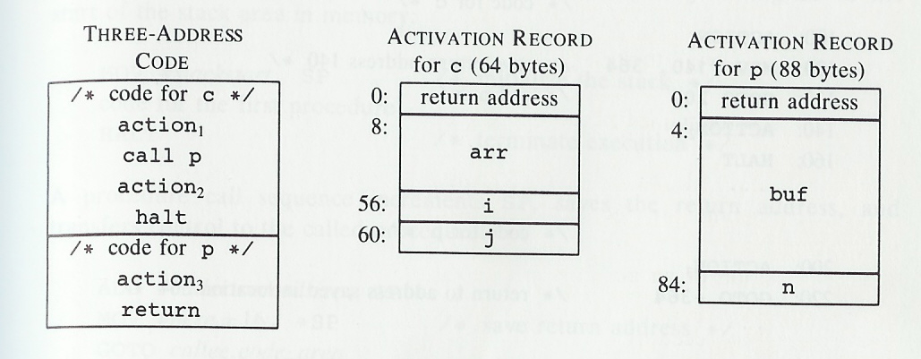
Sample of Activation Records
Assume that run-time memory has areas for code, static data, and optionally a stack
Heap is not being used in these examples
Fig.9.4 Input to a code generator

Slide 15
Static Allocation (P.522)
A call statement in the intermediate code is implemented by two target-machine instructions:
MOV callee.static_area, #here+20
GOTO callee.code_area
The MOV instruction saves the return address
The GOTO statement transfers control to the target code of the called procedure
A return statement in the intermediate code is implemented by one target-machine instruction:
GOTO *callee.static_area

Slide 16
Sample Code
/* code for c */
100: action1
120: MOV 364, #140 /* save return address 140 */
132: GOTO 200 /* call p */
140: action2
160: HALT
…
/* code for p */
200: action3
220: GOTO *364
…
/* 300-363: activation record for c */
300: /* return address */
304: /* local data for c */
…
/* 364–451: activation record for p */
364: 140 /* return address */
368: /* local data for p */

Slide 17
Stack Allocation (1) (P.524)
Stack allocation uses relative addresses for storage in activation records
Address can be offset from any known position in activation record
Book uses positive offset from SP, a pointer to beginning of activation record at top of stack
The position of an activation record is not known until run-time
This position is usually stored in a register
The indexed address mode is convenient
Notes:
indexed address mode : offset(sp); *+sp(offset)

Slide 18
Stack Allocation (2)
The code for the first procedure initializes the stack:
MOV SP, #stackstart
…code for the first procedure…
HALT
A procedure call increments SP, saves the return address, and transfers control:
ADD SP,SP, #caller.recordsize
MOV SP, #here+16
GOTO callee.code_area
A return sequence has two parts:
First control is transferred to the return address
GOTO [SP,#0]
Next, in the caller, SP is restored to its previous value
SUB SP,SP, #caller.recordsize

Slide 19
Activation record in stack
high
SP(old)
frame
Return address
SP
low

Slide 20
Basic Blocks (P.528)
A basic block is a sequence of statements such that:
Flow of control enters at start
Flow of control leaves at end
No possibility of halting or branching except at end
A name is "live" at a given point if its value will be used again in the program
Each basic block has a first statement known as the "leader" of the basic block

Slide 21
Partitioning Code into Basic Blocks—algorithm 9.1 (P.529)
First algorithm must determine all leaders:
The first statement is a leader
Any statement that is the target of a conditional or unconditional goto is a leader
Any statement immediately following a goto or unconditional goto is a leader
A basic block:
Starts with a leader
Includes all statements up to but not including the next leader

Slide 22
Basic Block Example
(1) prod := 0
(2) i := 1
(3) t1 := 4 * i
(4) t2 := a[t1]
(5) t3 := 4 * i
(6) t4 := b[t3]
(7) t5 := t2 * t4
(8) t6 := prod + t5
(9) prod := t6
(10) t7 := i + 1
(11) i := t7
(12) if i <= 20 goto 3
(13) …
begin
prod := 0;
i := 1;
do
begin
prod := prod + a[i] * b[i]
end
while i <= 20
end

Slide 23
Transformations on Basic Blocks (P.530)
A basic block computes a set of expressions
The expressions are the values of names that are live on exit from the block
Two basic blocks are equivalent if they compute the same set of expressions
Certain transformations can be applied without changing the computed expressions of a block
An optimizer uses such transformations to improve running time or space requirements of a program
Two important classes of local transformations:
structure-preserving transformations
algebraic transformations

Slide 24
structure-preserving transformations (1)
Common subexpression elimination:
Dead-code elimination
Suppose the statement x := y + z appears in a basic block and x is dead (i.e. never used again)
This statement can be safely removed from the code
a := b + c
b := a – d
c := b + c
d := a - d
a := b + c
b := a – d
c := b + c
d := b

Slide 25
structure-preserving transformations (2)
Renaming of Temporary variables
Suppose the statement t := b + c appears in a basic block and t is a temporary
We can safely rename all instances of this t to u, where u is a new temporary
A normal-form block uses a new temporary for every statement that defines a temporary
Interchange of two independent adjacent statements
Suppose we have a block with two adjacent statements:
t1 := b + c
t2 := x + y
If t1 is distinct from x and y and t2 is distinct from b and c, we can safely change the order of these two statements
Notes:
distinct清楚的, 明显的, 截然不同的, 独特的

Slide 26
Algebraic Transformations
Algebraic Transformations:
Statements such as x := x + 0 or x := x * 1 can be safely removed
Statement x := y ^ 2 can be safely changed to x := y * y

Slide 27
Flow Graphs (P.532)
A graphical representation of three-address statements, useful for optimization
Nodes represent computations
Each node represents a single basic blocks
One node is distinguished as initial
Edges represent flow-of-control
There is an edge from B1 to B2 if and only if B2 can immediately follow B1 in some execution sequence:
True if there is an conditional or unconditional jump from the last statement of B1 to the first statement of B2
True if B2 immediately follows B1 and B1 does not end with an unconditional jump
B1 is a predecessor of B2, B2 is a successor of B1

Slide 28
Representations of Flow Graphs
A basic block can be represented by a record consisting of:
A count of the number of quadruples in the block
A pointer to the leader of the block
The list of predecessors and successors
Alternative is to use linked list of quadruples
Explicit references to quadruple numbers in jump statements can cause problems:
Quadruples can be moved during optimization
Better to have jumps point to blocks

Slide 29
Loops and Flow Graphs
A loop in a collection of nodes in a flow graph such that:
There must be a path of length one or more connecting any two nodes in the collection
If all such paths exist, the nodes in the collection are said to be strongly connected
The collection of nodes must have a unique entry node
The only way to reach a node in the loop from a node outside the loop is to go through entry
A loop that contains no other loops is called an inner loop

Slide 30
Next-Use Information (P.534)
The use of a name in a three-address statement is defined as follows:
Suppose statement i assigns a value to x
Suppose statement j has x as an operand
We say that j uses the value of x computed at i if:
There is a path through which control can flow from statement i to statement j
This path has no intervening assignments to x
For each three-address statement that is of the form x := y op z
We want to determine the next uses of x, y, and z
For now, we do not consider next uses outside of the current basic block

Slide 31
Determine Next-Use
Scan each basic block from end to beginning
At start, record, if known, which names are live on exit from that block
Otherwise, assume all non-temporaries are live
If algorithm allows certain temporaries to be live on exit from block, consider them live as well
Whenever reaching a three address statement at line i with the form x := y op z
Attach statement i to information in symbol table regarding the next use and liveliness of x, y, and z
Next, in symbol table, set x to "not live" and "no next use"
Then set y and z to "live" and the next uses of y and z to I
A similar approach is taken for unary operators

Slide 32
Reusing Temporaries
It is sometimes convenient during optimization for every temporary to have its own name
Space can be saved, however, by reusing temporary names
Two temporaries can be packed into the same location if they are not live simultaneously
t1 := a * a
t2 := a * b
t3 := 2 * t2
t4 := t1 + t3
t5 := b * b
t6 := t4 + t5
t1 := a * a
t2 := a * b
t2 := 2 * t2
t1 := t1 + t3
t2 := b * b
t1 := t1 + t2

Slide 33
A Simple Code Generator (P.535)
The book describes a simple code generator
Generates target code for a sequence of three-address statements
Considers statements one at a time:
Remembers if any of the operands are currently in registers
Takes advantage of that if possible
Assumes that for each operator in three-address code there is a corresponding target-language operator
Also assumes that computed results can be left in registers as long as possible, storing them only:
If their register is needed for another computation
Just before a jump, labeled statement, or procedure call

Slide 34
Register and Address Descriptors
A register descriptor keeps track of what is currently in each register
Consulted whenever a new register is needed
Assumes that all registers are empty at the start of a basic block
An address descriptor keeps track of the location where the current value of a name can be found
The location might be a register, a memory address, a stack location, or some set of these
The information can be stored in a symbol table
The information is used to determine how to access the value of a name

Slide 35
Code-Generation Algorithm (P.537)
For each three-address statement x := y op z perform the following actions:
Invoke a function getreg which determines the location L where the result should be stored
L will usually be a register but could be a memory location
Consult the address descriptor for y to determine y', one of the current locations of y
If the value of y is not already in L, generate the instruction MOV L, y' to place a copy of y in L
Generate the instruction OP L,L,z', where z' is the chosen current location of z
If the current value of y or z is in a register and is no longer needed, update the register descriptor
The actions for unary operators are analogous
A simple assignment statement is a special case

Slide 36
Implementing getreg (1) (P.538)
The function returns the location L to hold the result of x := y op z
If y is already in a register:
L can be set to y if the following conditions are true:
The name y is not live after exiting the block
There is no next use of y after the execution of the statement, then return the register of y for L.
In this case, update the address descriptor of y to indicate that the value of y is no longer in L.
Otherwise, if there is an empty register, use it

Slide 37
Implementing getreg (2)
Otherwise, if x has a next use in the block or op requires a register, then:
Choose an occupied register R
For every variable in R
If the variable is not also in memory, execute an instruction MOV M, R
Update the appropriate address descriptor
Set L to R
Otherwise, select the memory location of x for L

Slide 38
Code Generation Example (1)
Consider the statement
d := (a - b) + (a - c) + (a - c)
This may be translated into the following three-address code:
t := a – b
u := a – c
v := t + u
d := v + u
Assume that d is live at end of block
Assume that a, b, and c are always in memory
Assume that t, u, and v, being temporaries, are not in memory unless explicitly stored with a MOV instruction

Slide 39
Code Generation Example (2)
Statements | Generated Code | Register Descriptor | Address Descriptor
 |  | registers empty
t := a - b | MOV R0, a | R0 contains t | t in R0
 | SUB R0,R0,b
u := a - c | MOV R1, a | R0 contains t R1 contains u | t in R0 u in R1
 | SUB R1,R1,c
v := t + u | ADD R0,R1,R0 | R0 contains v R1 contains u | v in R0 u in R1
d := v + u | ADD R0,R1,R0 | R0 contains d | d in R0
 | MOV d, R0 | R0 contains d | d in R0 and memory

Slide 40
Conditional Statements (1) (P.541)
Implemented in one of two ways
One way: branch if value of designated register meets one of six conditions
Six conditions are negative, zero, positive, nonnegative, nonzero, and nonpositive
To implement a three-address statement such as
if x < y goto z
Subtract x from y in register R
If value in R is negative jump to z
Notes:
MOV x, R0
SUB y, R0
CJ< z

Slide 41
Conditional Statements (2)
A second approach uses a set of condition codes
Codes indicate whether the last quantity computed or loaded into a register is negative, zero, or positive
Many machines use a compare instruction cmp that sets a condition code without subtracting
Other instructions will compare and jump if the condition code meets certain criteria
To implement the statement if x < y goto z, first execute CMP x, y and then CJ< z
A condition-code descriptor stores the name (or pair of names compared) that last set the condition code
MOV R0, y
ADD R0,R0,z,
MOV x, R0
CJ< z
x := y + z
if x < 0 goto z
Notes:
CMP x, y
CJ< z

Slide 42
Register Allocation (P.541)
Register allocation decides which values in a program reside in registers
Register assignment decides in which register each value resides
Often certain registers are reserved for certain purposes:
base registers
stack pointers
Remaining registers remain free for compiler to do with what it likes

Slide 43
Global Register Allocation (P.542)
Previously discussed strategy stores all registers at the end of each block
To eliminate stores and loads, assign some registers to frequently used variables
Keep these registers consistent across block boundaries
Assuming we know which values are used outside of a basic block
Fact: many programs spend most of their execution time in inner loops
Some compilers assign fixed number of registers to hold the most active values in each inner loop
Some languages allow programmer to specify register declarations

Slide 44
Usage Counts (P.542)
Usage counts determine the benefit from allocating a register for a variable x in a loop L
For each basic block B in L:
We save one unit cost for each use of x in B preceding a definition of x in B
We save two units if we can avoid a store of x at the end of the block
Such storage would be necessary if x is assigned a value in B and live on exit from B
There is some cost at entry and exit from loop, but if loop has many iterations, that is negligible

Slide 45
Directed Acyclic Graphs (DAGs) (P.546)
A dag for a basic block is a directed acyclic graph such that:
Leaves, represent the initial values of name
Labeled by unique identifiers, either variable names or constants
Operator applied to name determines if l-value or r-value is needed; usually it is r-value
Interior nodes are labeled by an operators
Nodes are optionally also given a sequence of identifiers (identifiers that are assigned its value)
Useful for implementing transformations on and determining information about a basic block

Slide 46
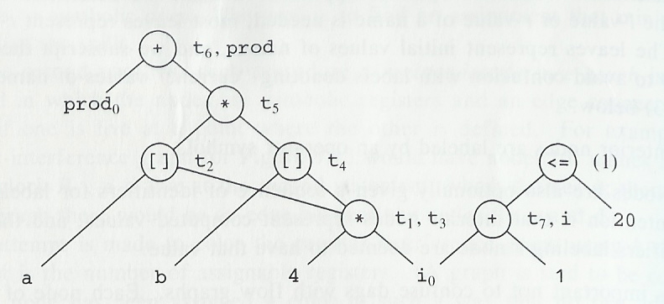
Dag Example

Slide 47
Using Dags
A dag can be automatically constructed from code using a simple algorithm
Several useful pieces of information can be obtained:
Common subexpressions
Which identifiers have their values used in the block
Which statements compute values that could be used outside the block
Can be used to reconstruct a simplified list of quadruples
Can evaluate interior nodes of dag in any order that is a topological sort (all children before parent)
Heuristics exist to find good orders
If dag is a tree, a simple algorithm exists to give optimal order (order leading to shortest instruction sequence)

Slide 48
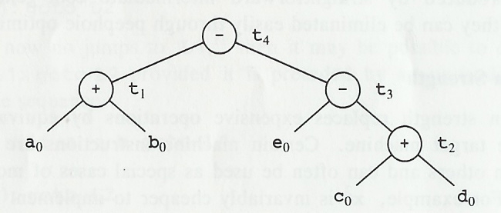
Generating Code from Dags (1) (P.557)
t₁ := a + b
t₂ := c + d
t₃ := e – t₂
t₄ := t₁ – t₃
t₂ := c + d
t₃ := e – t₂
t₁ := a + b
t₄ := t₁ – t₃

Slide 49
Generating Code from Dags (2)
Assume only t₄ is live on exit of previous example and two registers (R0 and R1) exist
Code generation algorithm discussed earlier leads to following solutions (second saves two instructions)
LDR R10, =c
LDR R11, =d
LDR R0, [R10]
LDR R1, [R11]
ADD R0,R0,R1
LDR R10, =e
LDR R1,[R10]
SUB R1,R1,R0
LDR R10, =a
LDR R11, =b
LDR R0, [R10]
LDR R2, [R11]
ADD R0,R0,R2
SUB R0,R0,R1
LDR R10,=t4
STR R0, [R10]
MOV R0, a
ADD R0,R0,b
MOV R1, c,
ADD R1,R1,d
MOV t_{1,} R0
MOV R0,e
SUB R0,R0,R1
MOV R1, t₁
SUB R1,R1,R0
MOV t₄, R1
MOV R0, c
ADD R0,R0,d
MOV R1, e
SUB R1,R1,R0
MOV R0, a
ADD R0,R0,b
SUB R0,R0,R1
MOV t₄, R0
ARM assemble codes

Slide 50
Exercises
int i=1,j=2,a,b=2,c=3;
if (i<j)
a=b+c;
else
a=b-c;

